Slide 1
EN 410 Energy Management
Gurubalan Annadurai
guru.a@iitb.ac.in

Slide 2
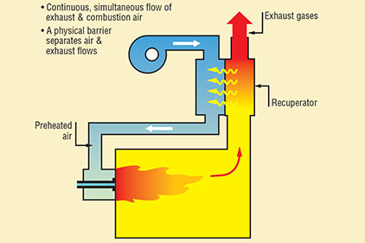
Furnace
A furnace is an equipment
to melt metals for casting
heat materials for change of shape (rolling, forging etc)
change of properties (heat treatment)
Equalisation of the temperature within the stock
Since the products of flue gases directly contact the stock, type of fuel chosen is of importance (e.g. tolerance to sulphur).
Solid fuels generate particulate matter that interferes with the stock
Liquid fuel, gaseous fuel or electricity

Slide 3
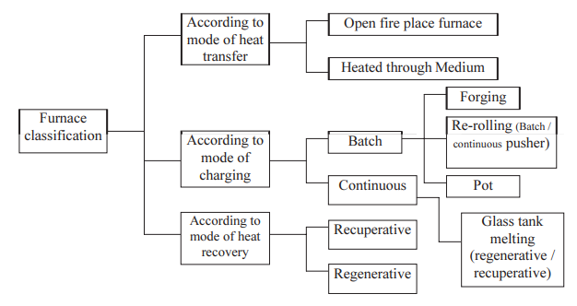
Classification of furnace

Slide 4
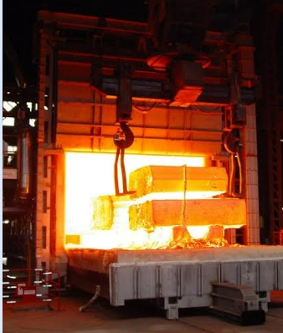
Forging furnace
1200-1250℃
Heat up time Soaking time Forging time
Soaked for 4-6 hrs for uniform temperature
Mostly manual

Slide 5
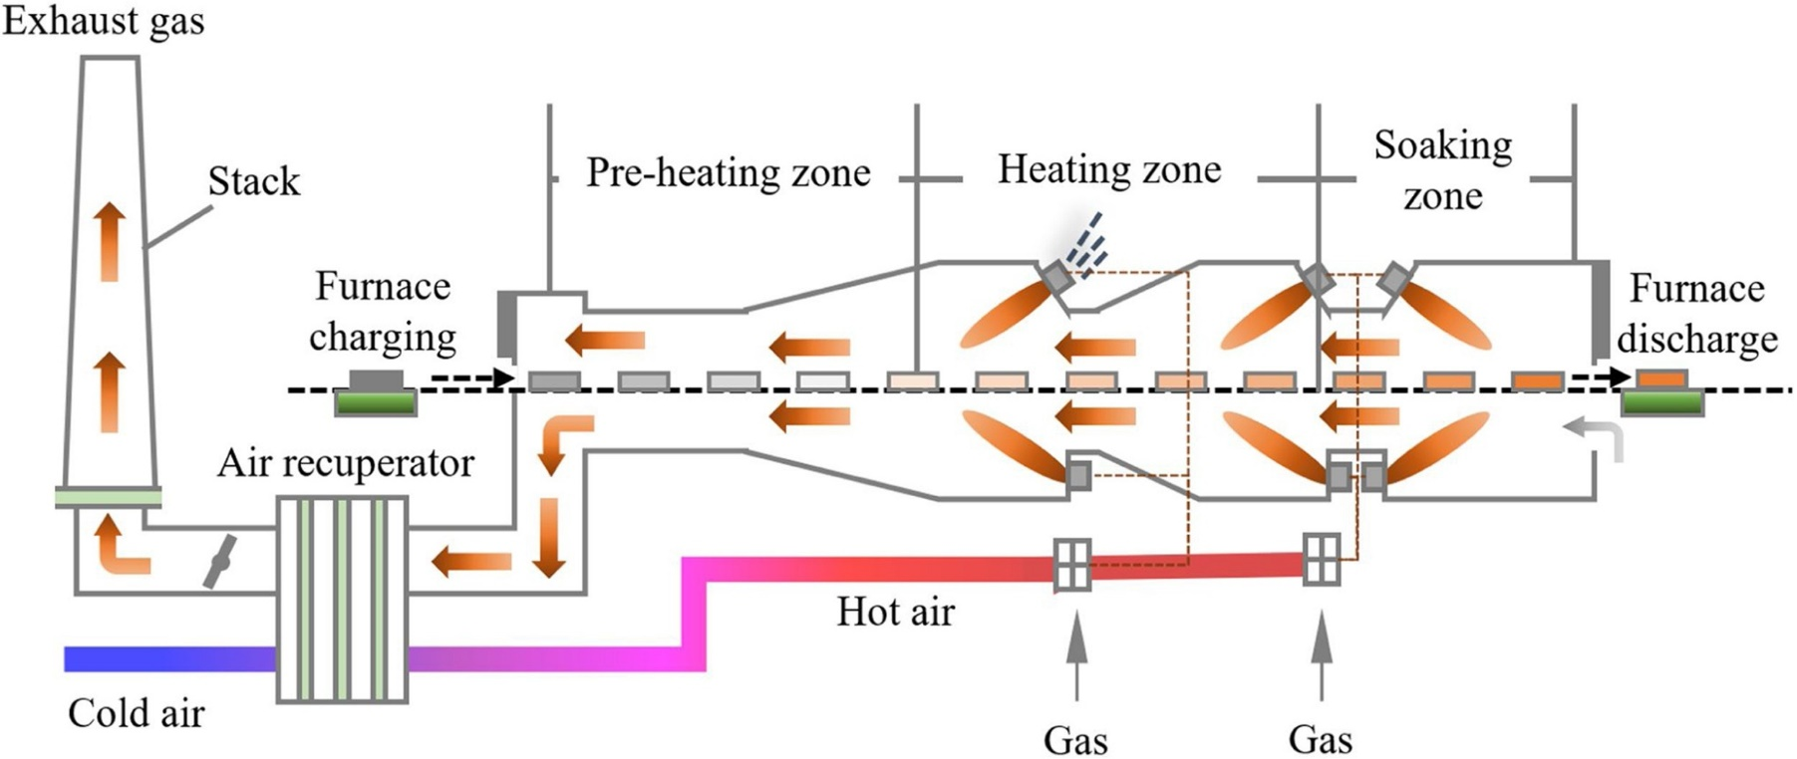
Continuous reheating furnace
Steel Industry
900-1250℃
Radiation and convection from the gases of the burner and the furnace walls

Slide 6
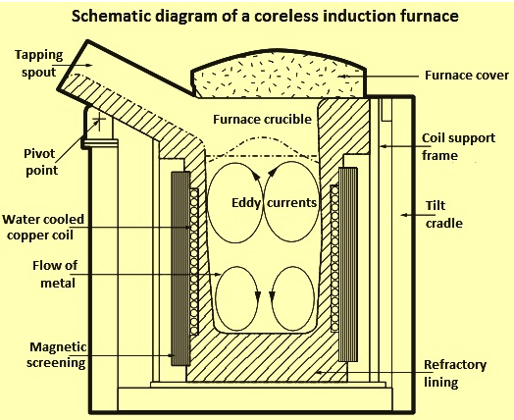
Induction furnaces
Crucible is cover with coper coil which carries powerful alternate current
Created magnetic field penetrates the melt and induces the eddy current by electromagnetic induction (production of an electromotive force (emf) across an electrical conductor in a changing magnetic field)
Eddy currents heat the meatal by Joule heating (passage of an electric current through a conductor produces heat)

Slide 7
Performance Evaluation
The Direct Method: Energy gain of the stock is compared with the energy content of the fuel
The Indirect Method: Efficiency is calculated based on losses and energy input

Slide 8
Losses in Furnaces
Flue gas loss
Stored heat loss: Energy stored in the furnace and insulation for uniform temperature during the start of cycle from cold to hot state (limited time of metal in the continuous furnace)
Insulation loss: Losses from the furnace outside walls or structure
Cooling water loss : Water is cicurated to maintain the temperature of rolls, bearings and doors
Material handling loss: Heat transported out of the furnace by the load conveyors, fixtures, trays, etc.
Opening loss: Radiation losses from openings, hot exposed parts, etc.
Heat carried by the cold air infiltration into the furnace due to the draft of flue gas, openings, etc.,
Heat carried by the excess air used in the burners.

Slide 9
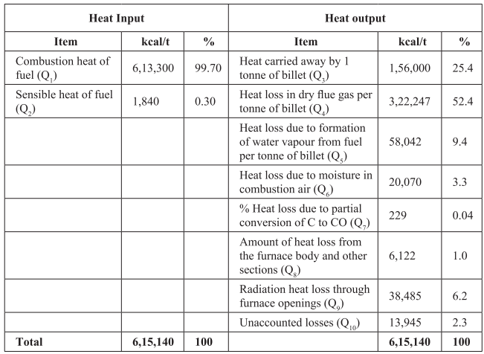
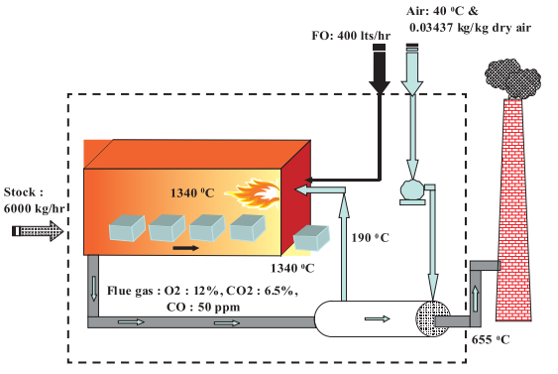
Furnace heat losses

Slide 10
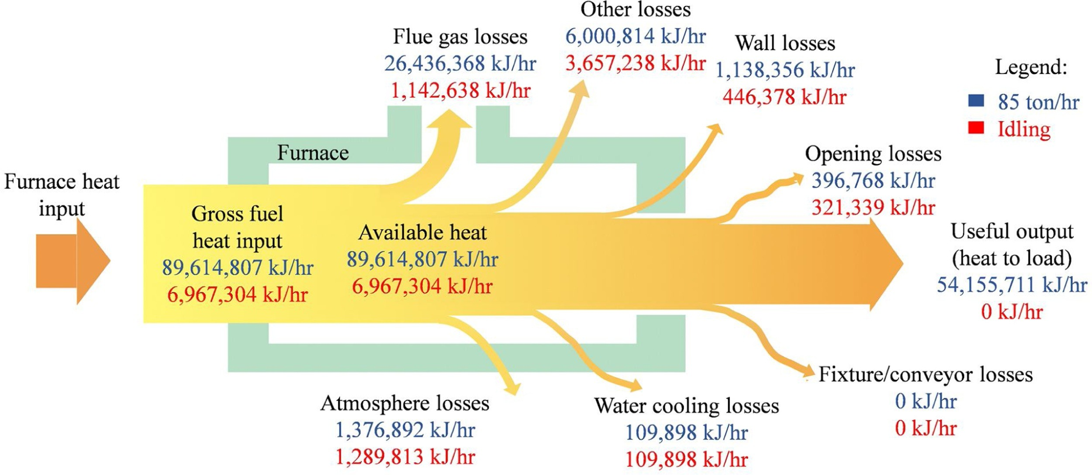
Heat losses in the IRFs for the steel plant, Winnipeg, Canada

Slide 11
Thermal Efficiencies: Industrial Furnaces

Slide 12
Furnace Instrumentation

Slide 13
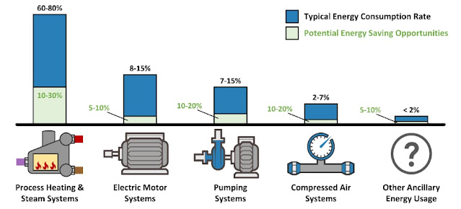
Energy Use

Slide 14
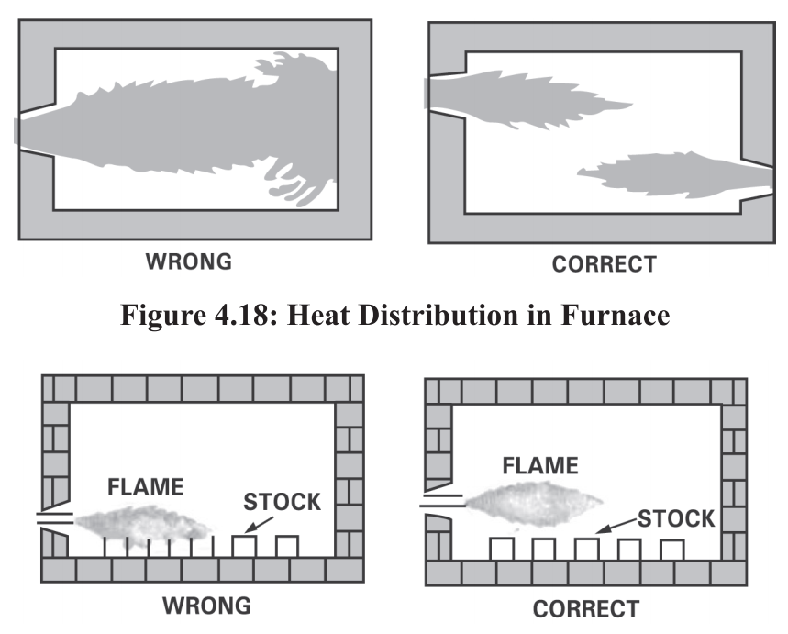
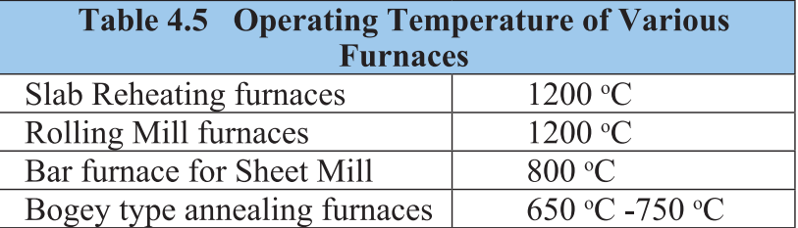
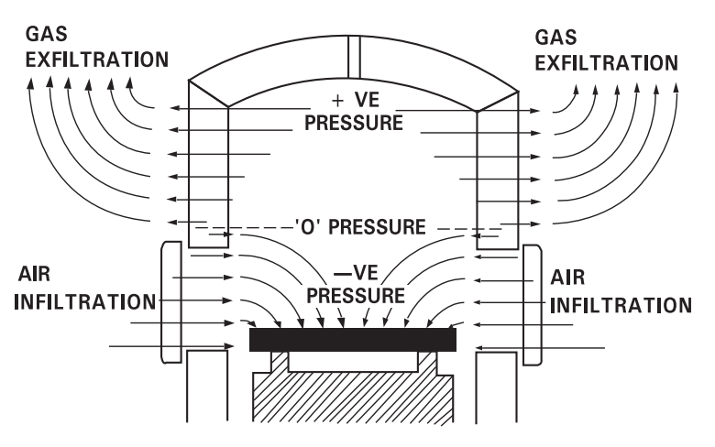
Energy Efficiency Measures
Waste heat recovery (to charge/air) from the flue gases
Proper heat distribution
Operating at the desired temperature
Air Inflation (upto 40%) / Reducing heat losses from furnace openings

Slide 15
Energy Efficiency Measures
Minimum wall losses by proper insulation
Use of ceramic coatings in furnace chamber – Emissivity increases with increase in temperature Easy to apply, 8-20% savings,
Complete combustion with minimum excess air
Optimum capacity utilization – charge loading

Slide 16
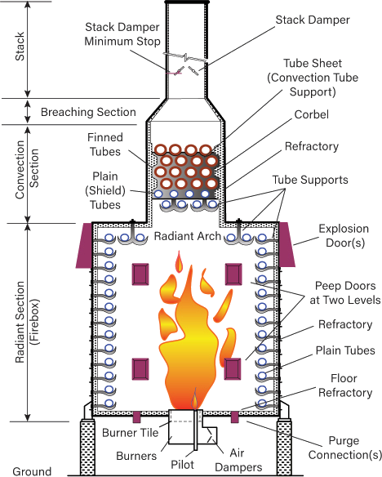
Fired Heaters
Energy and Cost intensive
Design varied according to fan and pipe arrangements

Slide 17
References
https://www.industrialheating.com/articles/91706-types-of-burners-and-combustion-systems
https://www.sciencedirect.com/science/article/pii/S0957582021000549#fig0005
https://www.ispatguru.com/steelmaking-by-induction-furnace/
https://www.energy.gov/sites/prod/files/2016/06/f32/QTR2015-6I-Process-Heating.pdf
https://blog.meadobrien.com/2022/03/benchmarking-energy-consumption-of.html
https://www.sciencedirect.com/science/article/pii/S1364032112003619#f0015
https://www.trust-ee.eu/discovery/process-heating
https://www.chemengonline.com/wp-content/uploads/2017/09/fired-heater-and-combustion-ebook-0916.pdf
https://namthien.vn/en/what-is-a-steam-trap/
https://processphase.com/steam-traps/
https://www.aiche.org/resources/publications/cep/2021/may/fired-heater-safety-common-failure-factors

